Slide 1
N
A
E
N
48th
A
N
N
U
A
L
2017
LEAVE TIME
Curtailing Absences
Carrots, Sticks & Clauses
Dominic D’Imperio
DIRECTOR OF EMPLOYER/EMPLOYEE RELATIONS
JEFFERSON-LEWIS-HAMILTON-HERKIMER-ONEIDA BOCES
Mark Pettitt
DIRECTOR OF PERSONNEL & LABOR RELATIONS
ONONDAGA-CORTLAND-MADISON BOCES

Slide 2
DEFINING PROBLEM
We gave it away
benefits v. salary
PERSONAL AND FAMILY
Unit members shall be allowed a total of twenty (20) days of leave per school year, nine (9) days of which shall be reserved for personal illness, without financial loss for the following purposes:
+ 9 Personal illness
+ 7 Family
+ 4 Personal
20

Slide 3
DEFINING PROBLEM
What are your numbers?
sick
personal
family
vacation
bereavement
20 days x 10 yrs = FULL YEAR OF LEAVE
Plus legal entitlements (paid or unpaid) beyond paid leave

Slide 4
DEFINING PROBLEM
Sick Leave v. Disability
Changing attitudes towards work & careers
Average worker today stays at each job 4.4 years (Bureau of Labor Statistics)
expected tenure of workforce’s youngest employees is about half that
91% of millennials (b. 1977-97) expect to stay in job less than 3 years (Future Workplace survey: “Multiple Generations @ Work”)
surveyed 1189 employees and 150 managers
could have 15 – 20 jobs during their working lives!

Slide 5
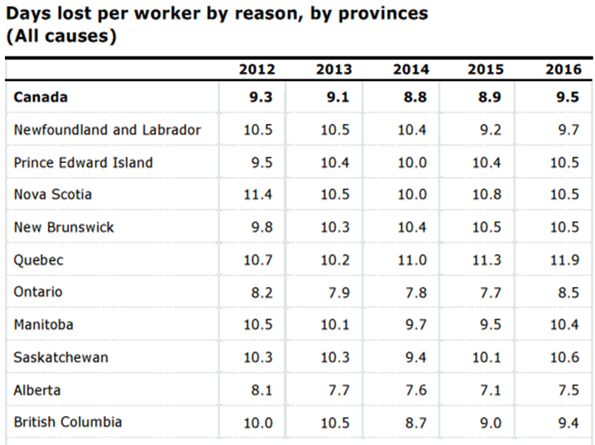
DEFINING PROBLEM Canada - Days lost/year, all EEs (sickness, family, personal)
http://www.statcan.gc.ca/tables-tableaux/sum-som/l01/cst01/labor60a-eng.htm

Slide 6
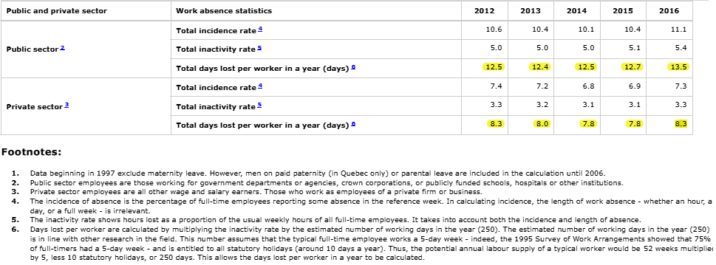
DEFINING PROBLEM Canada - Work Absences Public vs. Private Sector
Statistics Canada, Government of Canada: http://www5.statcan.gc.ca/cansim/a26?lang=eng&id=2790035

Slide 7
DEFINING PROBLEM: COSTS
Lack of Substitutes
fewer students going into education
enrollment in traditional teacher preparation programs (colleges, schools of education) declined 30% between 2010 and 2014, according to Title II reports
unemployment declined
more full-time or regular part-time employment opportunities
after a period of retrenchment
schools have begun hiring teachers and educational support staff
unemployed, but competent, certified teachers are being hired and no longer as available

Slide 8
DEFINING PROBLEM: COSTS
More Demand for Substitutes
teacher absences continue to be high
more time off of work is being paid than ever before, both in contracts and by law
minimum wage increases make substitutes harder to find and more expensive when available
State and Federal regulations require instructors out of classroom for PD, CSE meetings and other activities (take away from direct instruction)

Slide 9
DEFINING PROBLEM: COSTS
CANADA
New mothers may take 17-52 weeks of leave
depending on length of employment history and hours worked
Employers must accept employees back after mandated leave
into exact or equivalent job
at same rate of pay
with same employment benefits

Slide 10
DEFINING PROBLEM: COSTS
CANADA
Paid leave for one or both parents through employment insurance plan
Pregnant or new mother may take paid maternity leave of up to 15 weeks
Either parent may take 35 weeks of parental leave after child is born or adopted
Parents may share the leave however they choose
If eligible for program, the benefits equal 55-80% of the parent's average weekly insurable wage, to maximum of $485 per week

Slide 11
DEFINING PROBLEM: COSTS
UNITED STATES
The federal Family & Medical Leave Act (FMLA) provides up to 12 weeks of unpaid leave for several medical conditions, including the birth of a baby

Slide 12
DEFINING PROBLEM: COSTS
NEW YORK STATE
Family Leave (state level initiatives)
funded entirely through nominal employee payroll deduction
beginning in 2018: 50% of employee’s average weekly wage, capped at 50% of statewide average weekly wage
fully implemented in 2021: 67% of their average weekly wage, capped to 67% of statewide average weekly wage
eligible to participate after working 6 months with employer

Slide 13
DEFINING PROBLEM: COSTS
Family Leave (state level initiatives)
be wary of new proposals seeking to define “any paid leave” as service credit (as opposed to leave paid for and approved by District)
be wary of new proposals seeking to contractualize or guarantee full pay for state paid leave time (Districts make up the costs)

Slide 14
ADDRESSING ISSUE

Slide 15
ADDRESSING ISSUE: CARROTS
Pay for (near) perfect attendance
why pay for what is a professional expectation?
pay people who would show up any way
doesn’t dissuade from choosing to be sick and stay home
no measurable impact on employee use (abuse) of sick time
penalizes individuals for legitimate uses, i.e., pregnancy
Results: Nil

Slide 16
ADDRESSING ISSUE: CARROTS
Pay for unused days at retirement
change career expectations of teachers and job expectation of support staff
must be carefully structured
escalator effect
assumes career will be with one employer
rewards long-term attendance
Results: Better

Slide 17
ADDRESSING ISSUE: STICKS
Use attendance and absenteeism as factor for employment decisions
granting/denying tenure
work for probation period
add consequences for excessive or unwarranted leave use
Address the impacts of the absenteeism as informing decisions, not the reasons for the absenteeism
Results: Effective, but limited

Slide 18
ADDRESSING ISSUE: STICKS
Use attendance as factor in evaluation
can’t be effective if not present
how scored under an evaluation tool?
Notice - document and warn
basis of counseling
basis for discipline later
what is the standard?

Slide 19
ADDRESSING ISSUE: STICKS
Counseling Memos
track patterns
define excessive use
f ***ing arbitrators!
Clifford Donn
“Impact of absences on students and educational program is really of minimal importance.”
“The Federation is correct that it is improper for the BOCES to issue counseling memoranda for legitimate use of leave as provided in the collective bargaining agreement.”

Slide 20
ADDRESSING ISSUE: STICKS
Counseling Memos - Paul Caferra
“The District’s failure to specify an accurate date that the Grievant’s alleged misconduct occurred (the grievant was the one responsible for keeping the records that were incomplete and inaccurate) [was] a significant error that disadvantaged the Grievant and the Union...”
“The Record clearly demonstrates that, throughout most of the her employment, the Grievant has been a substandard employee (6 previous counseling memos over 3 years) and that ...the District would have been fully justified to impose significant discipline...”
The purportedly inaccurate date and the the judgment that the testimony of a 10-year-old student who heard the grievant snoring in her office was “unbelievable” meant that the District’s evidence … all the district’s evidence … “lacked credibility”

Slide 21
ADDRESSING ISSUE: STICKS
Doctor’s notes
Medical and psychological exams (fitness for duty determinations)
Disciplinary Charges

Slide 22
ADDRESSING ISSUE: NEGOTIATIONS
DATA
Regional comparisons contract provisions
days allotted
restrictions on use
Three year look at leave time usage
shows patterns
comparison in district, across titles
eliminates issue of “bad year”
Cost of substitutes

Slide 23
ADDRESSING ISSUE: NEGOTIATIONS
Review Contract Language
Restrictions on requesting doctor notes
Definition of a personal day or other days
give reason(s) for personal leave
restrict use before and after holiday or break
require documentation

Slide 24
ADDRESSING ISSUE: NEGOTIATIONS
Create incentives to accrue sick leave for retirement
set benchmarks
escalating incentives for additional days

Slide 25
ADDRESSING ISSUE: NEGOTIATIONS
Unpaid Leave means loss of pay and District’s cost of benefits for the day
FICA + EE Retirement = 21.45% x Daily Rate
Health Insurance
$33/day for Individual
$80/day for Family
Eliminate “use it or lose it” leave benefits
Control/Schedule PD outside of the school day/year

Slide 26
ADDRESSING ISSUE: ROUND TABLE
What have you tried?
What have you proposed?
What actually works?

Slide 27
Thank you!
N
A
E
N
48th
A
N
N
U
A
L
2017
Enjoy the rest of
your day here in

