Slide 1
Teacher Instructional Hours and Assigned Time
Tracking and Managing to Ensure Compliance and Efficient Use of Human Resources

Slide 2
Agenda
Introduction
History and Governance
New Provincial Teachers’ Hours of Work Clause
Instructional and Assigned Time
Tracking Teacher Time
Managing Instructional and Assignable Time
Issues
System Efficiencies
Questions

Slide 3
History and Governance
Hours of Work Clause entered into CCSD Teacher Collective Agreement in 2005.
Arbitration ruling in 2009 provided more details on defining instructional and assignable duties.
CCSD governs hours of work through:
The Teachers’ Collective Agreement - has two clauses that pertain to instructional and assignable time for teachers.
Administrative Procedure – Instructional Time
Employee & Labour Relations - who works with each principal to track each teacher’s instructional and assigned time and ensure compliance with the Collective Agreement.

Slide 4
Clause 11.1 – Hours of Work
11.1 Hours of Work. Effective September 1, 2005, a school-based full-time equivalent teacher not in receipt of any salary allowance will not be assigned duties in excess of thirty (30) hours per week, averaged over the school year. A maximum of one thousand four hundred and thirty (1,430) minutes (23.83 hours) per week, averaged over the school year, shall be devoted to the instruction of students. The remainder of assignable hours shall be devoted to professional duties including, but not limited to, supervision of students, preparation, staff meetings, consultation, parent-teacher conferences, and administrative tasks.

Slide 5
Clause 11.2.2
11.2.2 Teachers will be expected to assume, outside of regular school class time, professional duties including, but not limited to, supervision of students, preparation, staff meetings and parent-teacher conferences. Extra-curricular activities will be the collective responsibilities of the staff of the school. Individual teachers choose from among these activities based upon their knowledge, skills and interests.

Slide 6
Administrative Procedure – Instructional Time
Provides more detail and clarity, including:
Definitions
Procedures
Instructional Time
Assigned Time
Extracurricular Activities
Time Free From Instruction (TFFI)
Part-time Teacher Deployment

Slide 7
New Province-Wide Hours of Work Clause
Effective September 1, 2017, with exceptions for Boards with existing hours of work clauses.
Negotiated at the provincial level.
Has annual teacher limits of 907 instructional hours and 1200 assigned hours.
Part-time teachers are pro-rated.
Applies to teachers and teachers receiving an allowance (Department Heads, etc.)
Does not apply to school administrators.

Slide 8
Instructional Time
Instructional Time has three components:
There must be a teacher and a student(s)
There must be a curricular component
There must be an evaluative component
CCSD Instructional Time includes:
Classroom and online instruction
Independent Study and Workplace Learning
Tutorials
Co-curricular field trips
Teacher advisory (TA)
Exam period

Slide 9
Assignable Time
Defined as all duties that are assigned by the principal.
For CCSD, this does NOT include extracurricular activities.
Professional responsibilities are NOT included (e.g. lesson planning, grading assignments, etc.)
Assignable time can include duties outside of the normal school day (i.e. evenings and weekends).
Time Free From Instruction (TFFI) is not considered assignable time unless the teacher is required to remain in the school. A teacher may leave the building during their TFFI time as long as they follow school sign-out procedures.

Slide 10
Assignable Time Examples
Non-instructional days
Supervision
Professional development and department meetings
Internal coverage
Time before and after each instructional day
Parent-teacher conferences
Staff meetings
Special Events (e.g. graduation, open house, etc.)
Time between classes (Jr. & Sr. High), but not including lunch

Slide 11
How is teacher time tracked?
CCSD uses three Excel templates
K-9 – for elementary and junior high schools
10-12 – for senior high schools
Individual – used to calculate the exact instructional and assigned time for a specific teacher.
Each principal receives either the K-9 or 10-12 template and the individual template.

Slide 12
Tracking Example – K-9

Slide 13
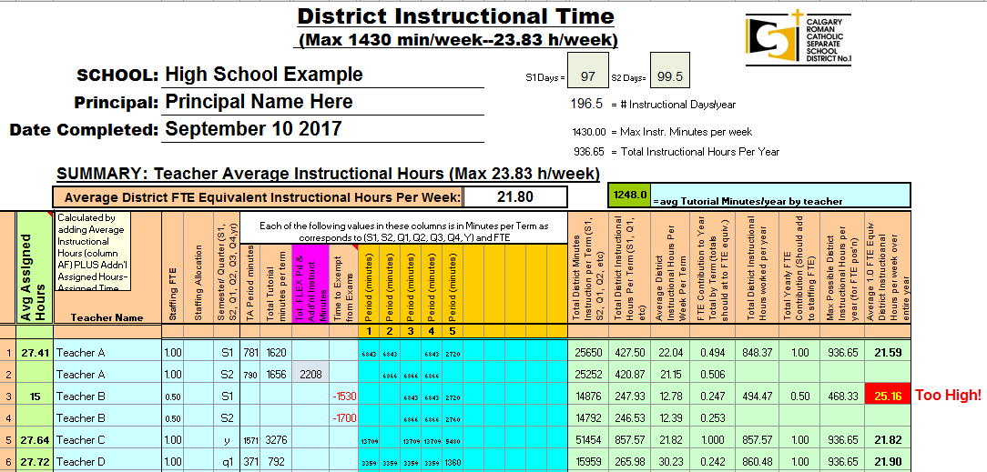
Tracking Example 10-12

Slide 14
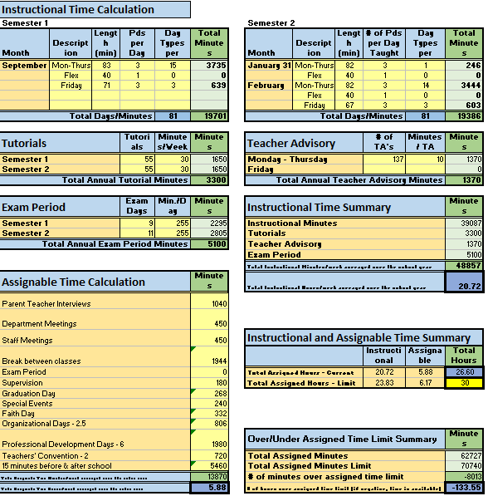
Tracking Example - Individual

Slide 15
Managing Instructional and Assignable Time – Phase 1
In January, Employee & Labour Relations prepares the templates for the coming school year once the District calendar has been finalized.
In late April, the school template is sent to each principal by Employee & Labour Relations, with completion of specific sections due by mid-May.
The principal enters their timetable for the coming school year and sends a copy of the template to Employee & Labour Relations.

Slide 16
Managing Instructional and Assignable Time – Phase 2
In mid-September, the principal enters the assigned duties and amount of TFFI time for their staff. The template will then calculate the instructional and assigned hours for each teacher.
A copy of the completed template is then sent to Employee & Labour Relations by late September.
The principal can refer to this template as assigned time needs arise (e.g. internal coverage, extra tutorial, etc.) during the school year to ensure relative equity amongst their staff.

Slide 17
Managing Instructional and Assignable Time – Phase 3
In early October, Employee & Labour Relations reviews each school template to ensure compliance with the collective agreement and then prepares summary reports for Senior Administration.
If any teacher is projected to be over either limit, adjustments are made to their schedule to ensure they will be compliant by the end of June.
Senior Administration reviews the summary reports to identify anomalies and make changes where necessary.

Slide 18
Tracking and Managing - Issues
Part-time teacher calculations (formula and scheduling TFFI)
Double-counting of minutes
TFFI vs. requiring staff to remain in the school
Co-curricular (e.g. Outdoor Education class) activities
Extracurricular activities.
Evening and weekend assigned events
How close to the limit do you go?
Culture of counting minutes

Slide 19
CCSD System Efficiencies
Employee & Labour Relations
Facilitates spreadsheet completion
Assists with resolution of issues
Provides training
Creates reports for Senior Administration
Minimizes School Administration Time
Minimizes Senior Administration Time
Facilitates good Labour Relations
Share calculations with Teacher Union – avoids grievances
Centralized model simplifies the process and ensures consistency

Slide 20
Questions?

